Slide 1



A*, Landmarks, and Triangle inequality (ALT) shortest path speed-up technique for Bi-modal User-adapted road networks
Academic year 2020 - 2021
Alexandre Heneffe – 000440761
Master Thesis in Computer Sciences
Promotor : Prof. Hugues BERSINI Supervisor : Matsvei TSISHYN
Notes:
Good morning
Thank you for attending my master thesis presentation

Slide 2
Introduction
Notes:
TODO : ajouter animation pour transition

Slide 3
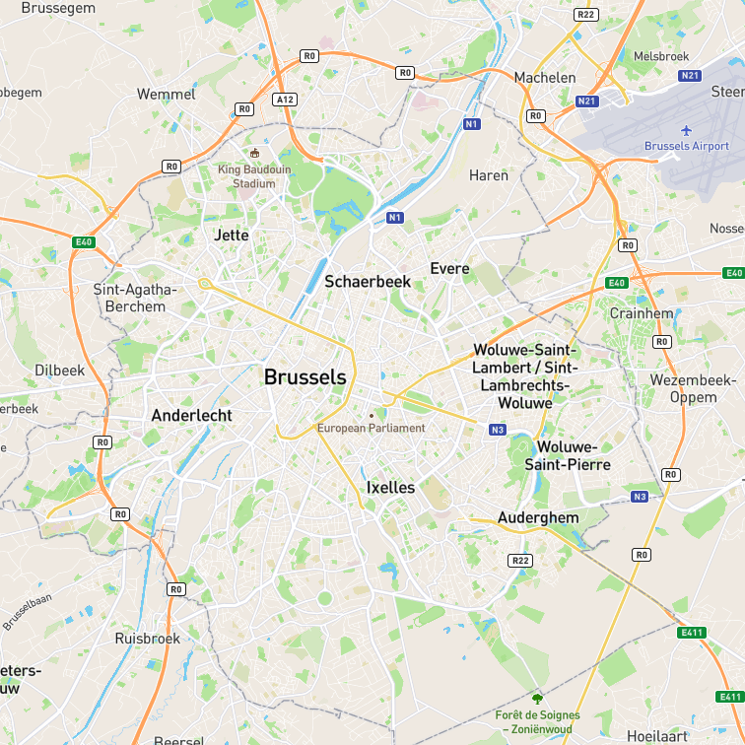

Introduction
Shortest path problem on road networks
Combinatorial optimization
Variants : Single source, single destination, single-pair, all-pairs
Speed-up techniques
E.g. Heuristic search, bidirectional search, landmarks, reaches, short-cuts, contractions…
ALT (A*, Landmarks and Triangle inequality)
Multi-modal routing
Multiple modalities (modes of transport) in a unique shortest path
Incentive to incorporate user preferences
Goal :
Apply ALT on multi-modal user-adapted road networks
Applicable without drastic loss in performance ?
Alexandre Heneffe
000440761
A*, Landmarks, and Triangle inequality (ALT) shortest path speed-up technique for Bi-modal User-adapted road networks
Notes:
The shortest path problem on road networks has become a well-studied field and there exist many simple algorithms that solve it.
It is a CO pb, variants…
The recent increasing amount of data forces us to find new techniques in order to considerably decrease their execution times. Several prominent speed-up techniques have emerged in the latest years.
In this thesis, we focus on ALT (A*, Landmarks and Triangle inequality) heuristic-preprocessing-based speed-up technique.
Besides, multi-modal routing has also been developing and brings new challenges compared to single-modal routing. Multi-modal routing consists in using multiple modalities in a unique shortest path
In particular, there is an incentive to incorporate user preferences.
We apply ALT on multi-modal user-adapted road networks modeled as directed graphs and conduct some experiments on multiple scenarios using real road networks data.
The goal is to determine if this technique is still applicable to such networks without drastically losing performance.d

Slide 4

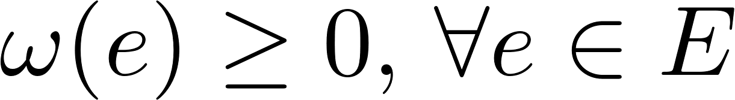
Shortest path problem
Given a directed weighted graph G = (V, E, ω) with non-negative edge weights.
V = vertices, E = arcs,
Denote
Weight function :
E.g. length
Alexandre Heneffe
000440761
A*, Landmarks, and Triangle inequality (ALT) shortest path speed-up technique for Bi-modal User-adapted road networks
Notes:
As a quick reminder, the shortest path problem consists in finding the path with minimal length between two nodes,
Formally, given a directed weighted graph with non-negative edge
Having non negative weights is important as some algorithm cannot deal with them

Slide 5
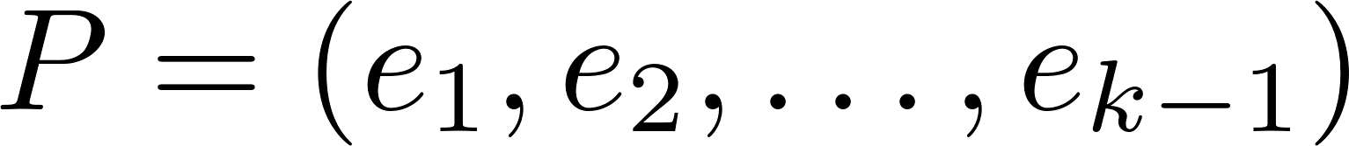
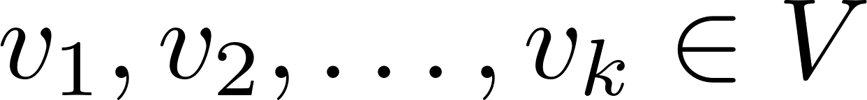
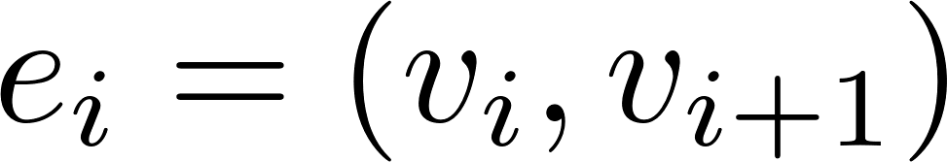
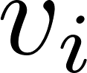
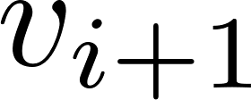
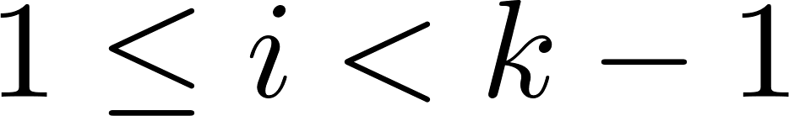
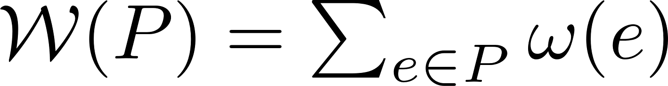
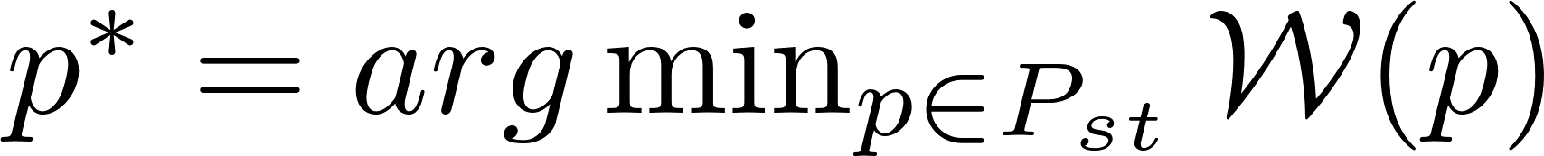
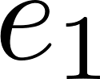
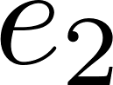
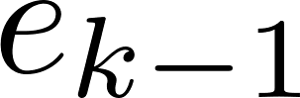
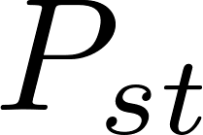
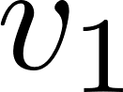
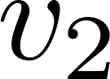
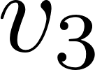
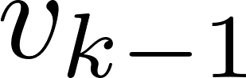
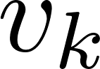
Shortest path problem
Simple path : sequence of distinct adjacent edges :
such that and adjacent to for
Path length :
Shortest path :
= path from s to t
Distance :
Triangle inequality :
Alexandre Heneffe
000440761
A*, Landmarks, and Triangle inequality (ALT) shortest path speed-up technique for Bi-modal User-adapted road networks
Notes:
A simple path is a sequence of distinct adjacent edges
The path length is the sum of the length of edges constituting it
The shortest path is the s-t path with minimal length
We define the distance as the length of the shortest path between s and t
It must satisfy the triangle inequality property
TODO : change explication for SP et Distance

Slide 6
State of the art
Notes:
We now look at the state of the art as well as some background for the experiments

Slide 7
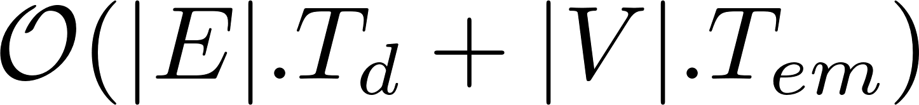
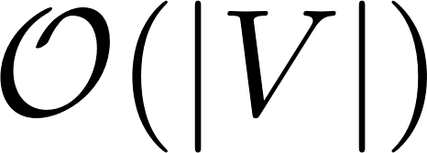
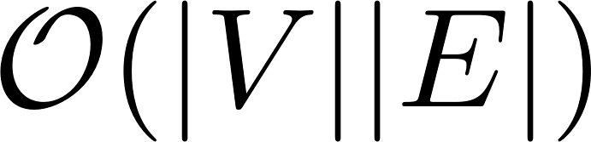
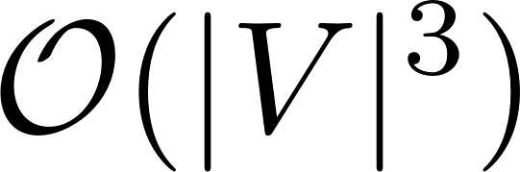
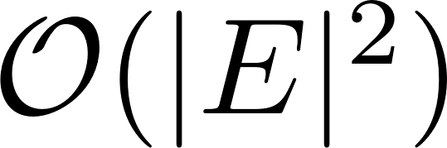
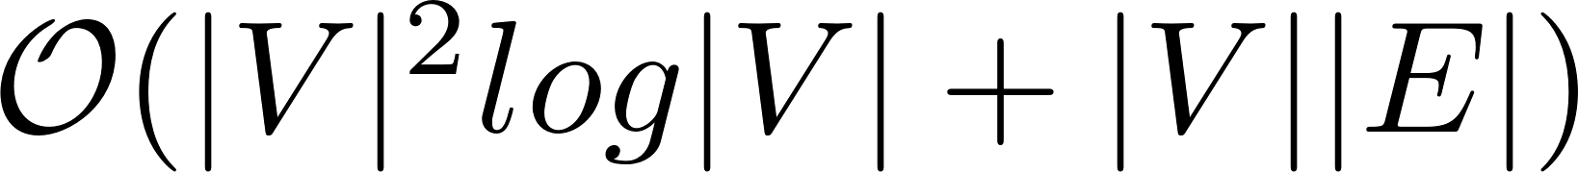
Simple algorithms
Complexity
Time Space
Dijkstra (E. W. Dijkstra - 1956)
Single source,
Single pair,
Single destination
Bellman-Ford (R. Bellman – 1956, L. R. Ford j. - 1958)
Single source,
Single destination
Floyd-Warshall (R. Floyd - 1962, B. Roy - 1959, S. Warshall - 1962)
All-pairs
Johnson’s algorithm (D. B. Johnson - 1977)
All-pairs
Alexandre Heneffe
000440761
A*, Landmarks, and Triangle inequality (ALT) shortest path speed-up technique for Bi-modal User-adapted road networks
Notes:
The shortest path problem can be solved by simple algorithms
Dijkstra’s algorithm is the classical algorithm to solve the shortest path pb
It solves the single source variant, but can be adapted to the single pair and single destination variants
Each algorithm deals with different variants of the pb
Bellmman-Ford can handle non-negative edge weights

Slide 8
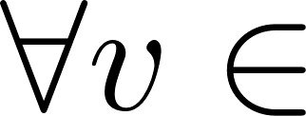


Dijkstra’s algorithm (simplified version)
Given a directed weighted graph G = (V, E) with non-negative weights, ω a weight function (edge length) and 2 nodes s, t.
Let X = a set of visited nodes and L(v) a distance label associated to each node v (shortest distance found so far).
Algorithm :
Init : X = Ø, L(v) = ∞, V \ {s}
While t X :
Pick node v V \ X such that L(v) is minimized using a priority queue
X = X U {v}
For each w such that (v,w) E and w V \ X, relax w :
If L(w) > L(v) + ω(v, w) then L(w) = L(v) + ω(v, w)
Simple array
Binary heap
Fibonacci heap
Alexandre Heneffe
000440761
A*, Landmarks, and Triangle inequality (ALT) shortest path speed-up technique for Bi-modal User-adapted road networks
Notes:
We quickly describe Dijkstra’s algorithm
Given a directed weighted graph with non-negative weights, we maintain a set X of visited nodes and a distance label L for each node (the shortest distance found so far)
While the destination node is not visited, we pick a node v such that its distance is minimal using a priority queue
The priority queue can be modeled with a simple array, a binary heap or a Fibonacci heap for example
Then, for each neighbour w, we relax its outgoing edges: if adding the new weight yields smaller edge, we update its label

Slide 9
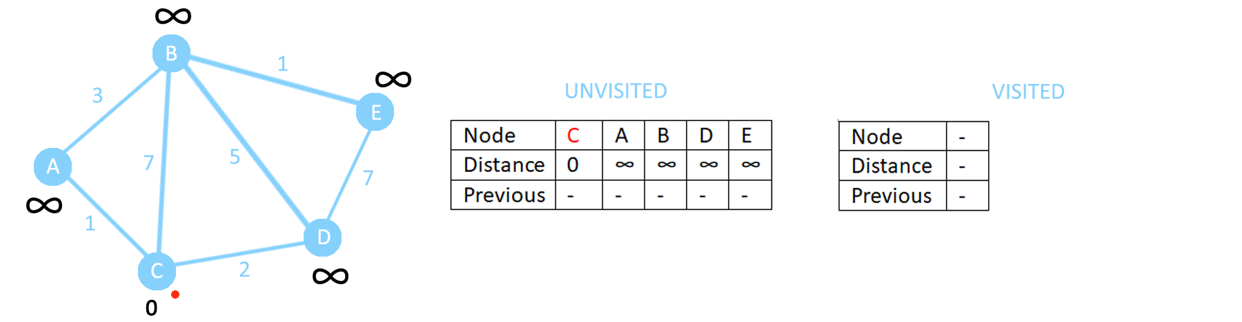
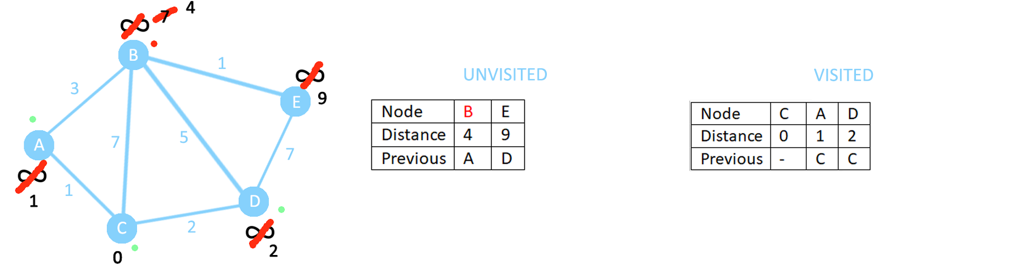
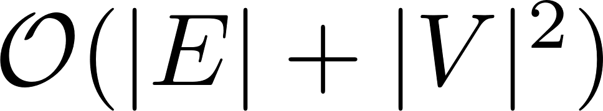
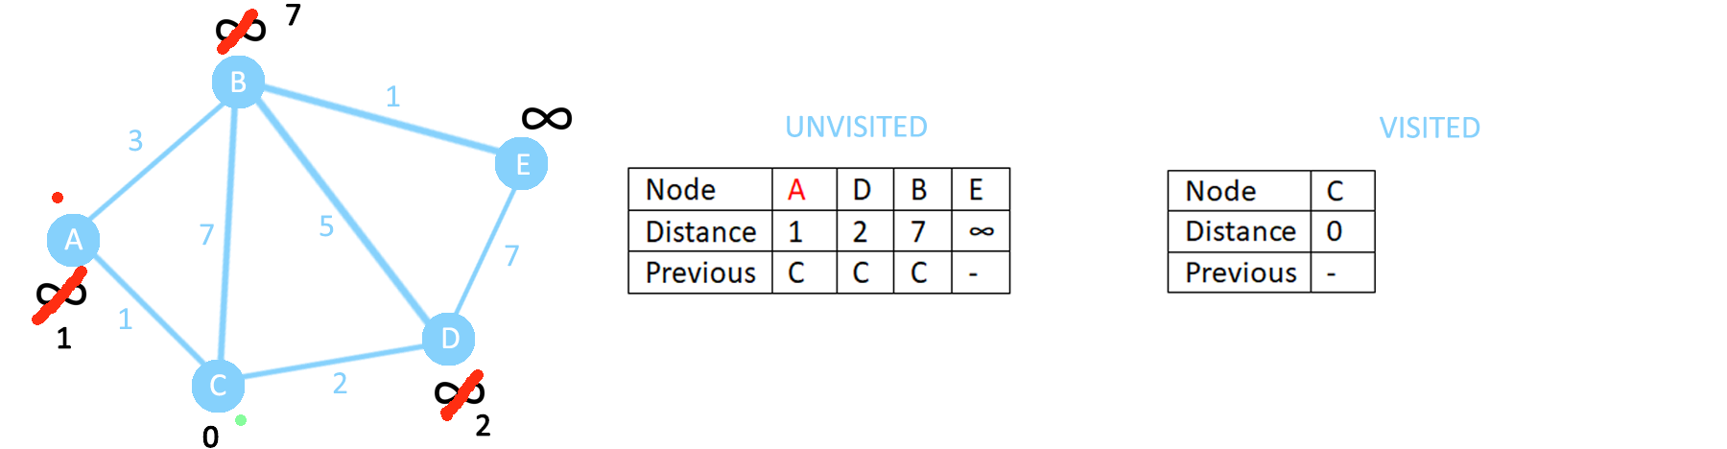
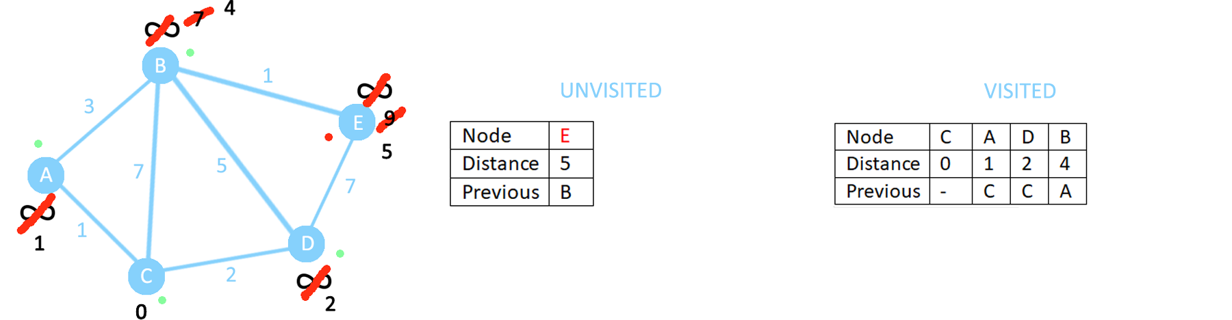
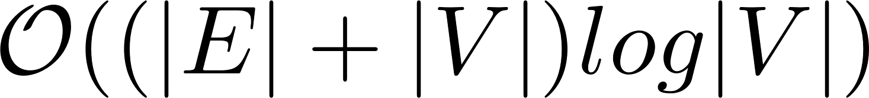
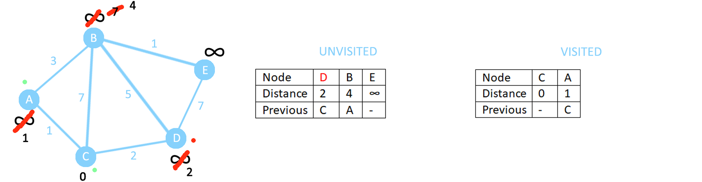
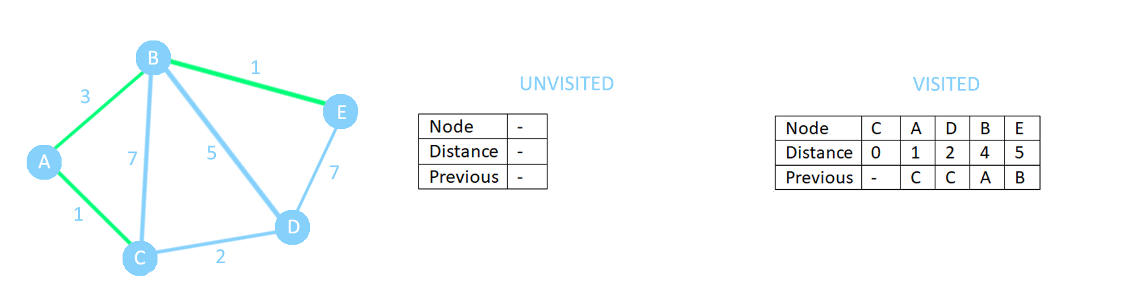
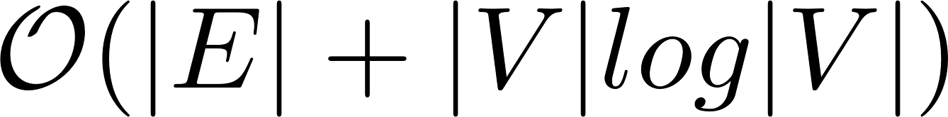
Dijkstra’s algorithm (simplified version)
Simple array
Binary heap
Fibonacci heap.
Alexandre Heneffe
000440761
A*, Landmarks, and Triangle inequality (ALT) shortest path speed-up technique for Bi-modal User-adapted road networks
Notes:
We can see that the data structure used to model the priority queue can significantly impact the time complexity of Dijkstra’s algorithm
Here we have an example of execution of Dijkstra’s algorithm. We will not enter in details

Slide 10
Speed-up techniques
Bidirectional search
Hierarchical
Exploits the notion of hierarchy in a network.
Some ways : different levels of importance (e.g. highways)
Goal-oriented
Idea : directing the search towards the destination by increasingly expanding the search space
Algorithms
Highway Hierarchies
Highway Node routing
Transit node routing
Contraction Hiérarchies
…
ALT
Arc-Flags
…
Alexandre Heneffe
000440761
A*, Landmarks, and Triangle inequality (ALT) shortest path speed-up technique for Bi-modal User-adapted road networks
Notes:
Now we talk about speed-up techniques
A simple technique is to do a bidirectional search
There are then two types of speed-up techniques :
Hierarchical :
It exploits the notion of hierarchy in a network. Indeed, some ways of a network can have different a level of importance regarding how likely they are chosen during the search process. (e.g. highways)
Goal-oriented :
It is based on the idea of directing the search towards the destination by increasingly expanding the search space

Slide 11
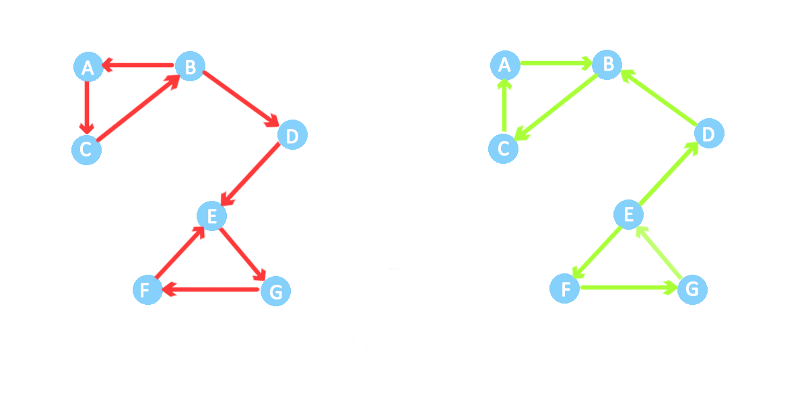
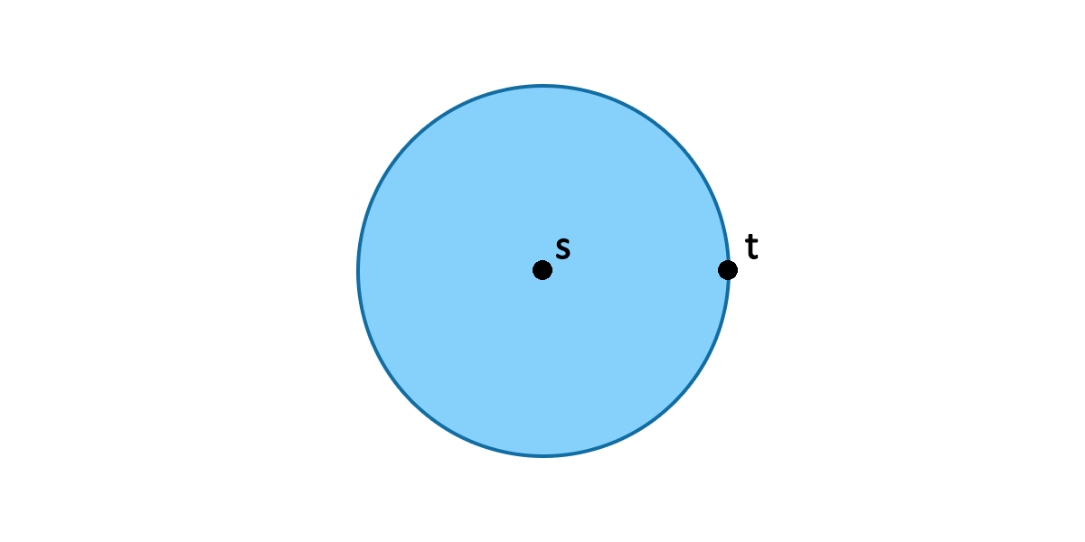

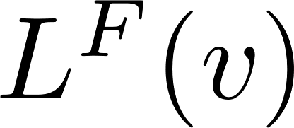

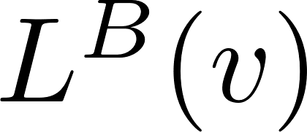
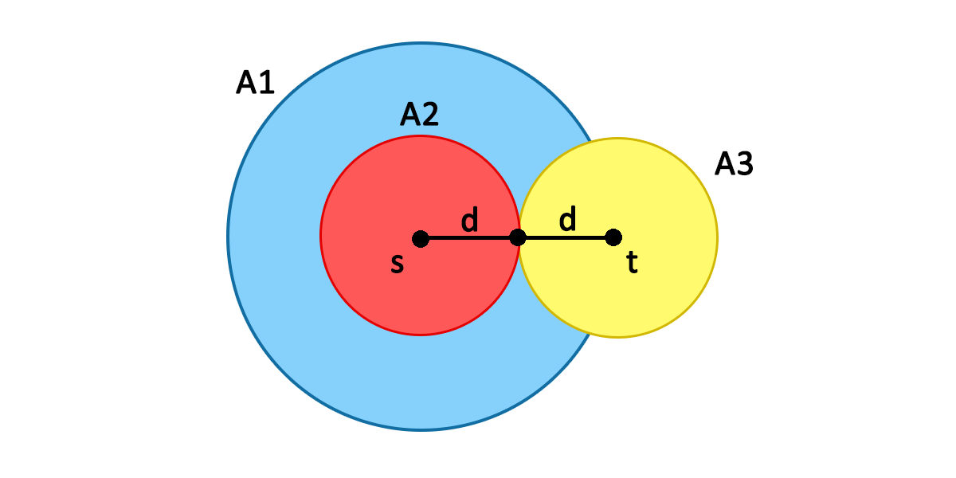
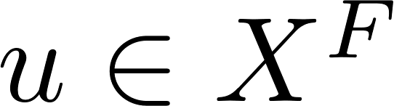
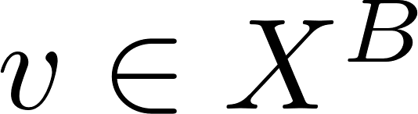
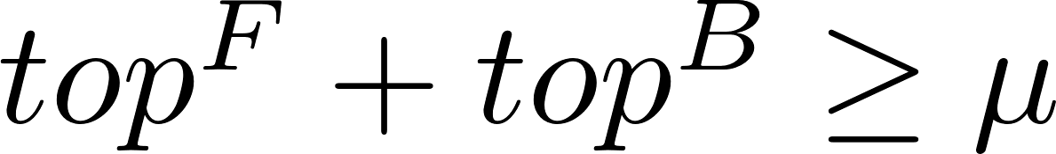
Bidirectional search
Dijkstra search space
2 searches :
Forward : from s in :
Backward : from t in :
Stopping condition :
μ = min path found so far
When (u, v) is scanned :
Update μ if
Stop when
(top = min value in priority queue)
Bidi-Dijkstra search space
Alexandre Heneffe
000440761
A*, Landmarks, and Triangle inequality (ALT) shortest path speed-up technique for Bi-modal User-adapted road networks
Notes:
Bidirectional search consists in 2 searches :
A forward search in the original graph
A backward search in the reverse graph
For each, we keep a distance label for each node v
For the Stopping condition, we define :
Mu : the minimal path found so far
During the algo, when an edge (u,v) is scanned, that is u is visited in the forward search and v in the backward search, we update mu if the new label is smaller than mu
And we stop when the sum of the minimal values in the priority queues is greater than mu
It can be shown that the search space of Bidirectional search is divided by 2 compared to that of Dijkstra’s algorithm

Slide 12

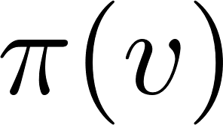

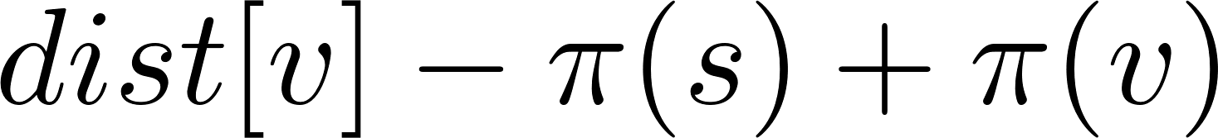
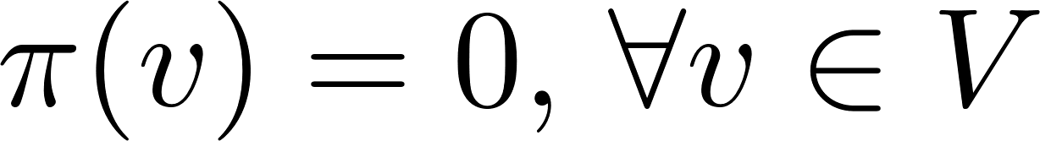
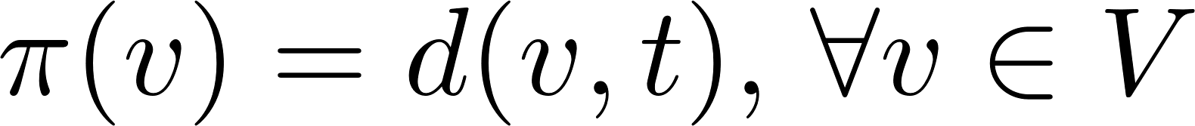
ALT (1)
Potential function : mapping vertices to real numbers :
= estimation of d(v,t) = lower bound
New edge weights :
is feasible if (non-negative)
A* : Dijkstra’s algorithm such that
Each step : pick v with minimal
= heuristic such that it never overestimates the actual distance d.
Worst case : = Dijkstra
Best case :
Euclidean distance
Manhattan distance
Octile distance
Alexandre Heneffe
000440761
A*, Landmarks, and Triangle inequality (ALT) shortest path speed-up technique for Bi-modal User-adapted road networks
Notes:
Now we present ALT, an speed-up technique that we will use extensively in the experiments
We define a potential function as a function that maps vertices to real numbers. It is an estimation of the actual distance from node v to destination node t, thus a lower bound
It yields new edge weights
The potential function is said to be feasible if it yields non negative edge weights
A* is Dijkstra with such weights. The potential function is an heuristic that never overestimates the actual distance, that is it is never bigger
In the worst case, with pi = 0, it is equivalent as running Dijkstra’s algo
In the best case, the heuristic is equal to the real distance, only edges from the shortest path will be selected

Slide 13
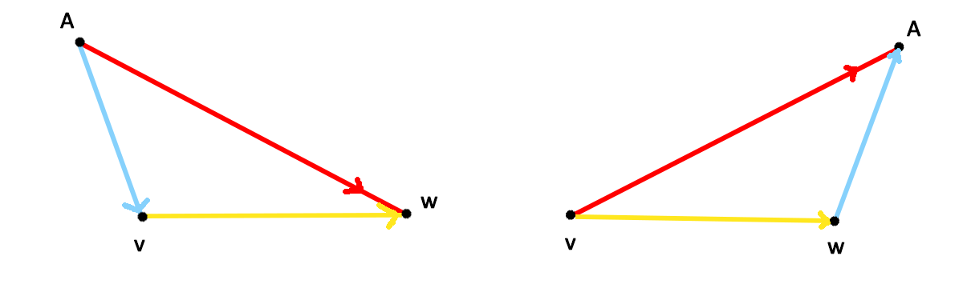
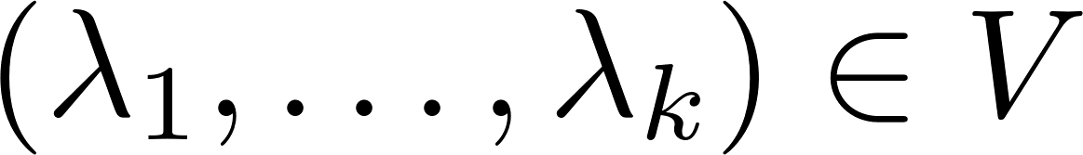
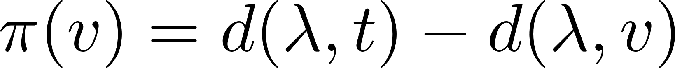
ALT (2)
Landmarks : Pick k landmarks
Precompute distances to and from all vertices
Feasible potential function :
Triangle inequalities :
Tightest lower bound of d(v,t) = heuristic for A* :
The tighest the lower bound = the bigger the search space reduction
Alexandre Heneffe
000440761
A*, Landmarks, and Triangle inequality (ALT) shortest path speed-up technique for Bi-modal User-adapted road networks
Notes:
We can select a set of k vertices called landmarks and pre-compute all distance to and from all vertices in a preprocessing phase
It can be shown that those landmarks define a feasible potential function
Then, from those distances, we can define 2 independent triangle inequalities,. They are lower bounds on the actual distance of any node
The tightest the lower bound, the better as the search space reduces.

Slide 14




ALT (3)
Selecting k optimal landmarks = NP Hard
Landmark selection :
Random (1) : select k landmarks randomly
Farthest (2) : start from center and go to farthest node
Planar (3) : split the map in k equivalent regions, then pick farthest node from center
1
2
3
Random
Farthest
Planar
Alexandre Heneffe
000440761
A*, Landmarks, and Triangle inequality (ALT) shortest path speed-up technique for Bi-modal User-adapted road networks
Notes:
Intuitively, given the triangle inequalities, landmarks should appear before or after each node, thus the best is at the borders
Note that selecting k optimal landmarks is known to be a NP hard problem
There are 3 main techniques to select landmarks :
Random : select k landmarks randomly
Farthest : start from a center node and go to the farthest node
Planar : split the map in k equivalent regions, then pick the farthest node from the center for each regions

Slide 15

Speed-up techniques
Preprocessing and average query time performance for speed-up techniques on the road network of Western Europe
(Reinhard Bauer et al.)
Advanced algorithms (combinations)
REAL (Goldberg et al. 2006)
Reach + ALT
SHARC (R. Bauer & D. Delling, 2010)
Shortcuts + Arc-Flags
Synergy with bidirectional search
…
Alexandre Heneffe
000440761
A*, Landmarks, and Triangle inequality (ALT) shortest path speed-up technique for Bi-modal User-adapted road networks
Notes:
There exists a lot of other speed-up techniques.
For example, we have combinations of speed-up techniques such as REAL (REACH + ALT), mixing hierarchical aspect with directed search
Bidirectional search can be combined with a lot of techniques as it only requires a reverse graph.

Slide 16











Multi-modal routing
2 modes of modalities :
Private
Foot
Bike
Car
…
Scheduling
Public
Free-floating service
Bike, scooters (e.g. Lime), cars, …
Stations
(e.g. Villo)
Public transportation
bus, train, tram, metro
Alexandre Heneffe
000440761
A*, Landmarks, and Triangle inequality (ALT) shortest path speed-up technique for Bi-modal User-adapted road networks
Notes:
Intermodal routing consists in mixing several modes of transportation using a single data structure
From a functional point of view, a multimodal network can be classified into 2 modes :
private such as foot, bike and cars
and public, which can be divided in 3 categories :
Free-floating service : the means of transport are available to the public everywhere in the city
Stations : A user can take a bike in a station then leave it in another station.
Public transportation : managed on a schedule and operated on predefined routes separated by stops where users can embark or disembark
Scheduling :
When applying the shortest path problem to multimodal graphs, we must pay attention to the ordering. For example, if a user chooses to take his personal car during a certain amount of time, then switch to a bike, he cannot use his car again later.

Slide 17





Multi-modal routing
Ex 2 : Walk + Villo stations
Data structure
Base layer
Foot layer
Shared-Car layer
n additional layers
Transition edges
Forward :
Backward :
Ex 1 : Walk + Public transport
Ex 3 : Walk + personal car
Alexandre Heneffe
000440761
A*, Landmarks, and Triangle inequality (ALT) shortest path speed-up technique for Bi-modal User-adapted road networks
Notes:
A simple way of modeling multimodal networks that we find in the litterature is to create different layers
First, a base layer where we can freely travel without constraint
N additionnal layers and then we add transition edges.
A forward edge starts in the base layer and ends in another layer
A backward which is the inverse : edge starts in a layer and ends in the base layer

Slide 18








User preferences
Model
Scalarized model :
Weighted sum
= preference coefficient
= nb of metrics
= edge weight of metric i
Multi-objective optimization :
X = feasible solutions,
= nb of objectives
Edge type :
Time independent (static)
Time dependent
Stochastic
Metrics
Time
Price
Ecological impact
Applicability
Label Correcting algorithm
Dijkstra, A*, ALT with weighted sum
Alexandre Heneffe
000440761
A*, Landmarks, and Triangle inequality (ALT) shortest path speed-up technique for Bi-modal User-adapted road networks
Notes:
To model user preferences, we have 2 different approaches :
The scalarized model: the weighted sum with a variable c which represents the user preference coefficient.
The edge costs can be
time independent (static costs),
time dependent (varying through time based on past events)
or stochastic : varying based on past events and real-time events
Considering time independent edge costs, we can have 3 main metrics:
Time (using the geographical distance),
price (average fuel price and average gas consumption of a car)
Ecological impact : hard to quantify, ex : amount of damaging éléments rejected by a heat engine such as carbon dioxyde, carbon monoxide, particles, …
Then, we have the second model : multi-objective optimization : minimizing an objective function given a set of feasible solutions
Considering the applicability, we can either use a label correcting algorithm (a multi-criteria model version of Dijkstra) or simply Dijkstra, and its variants with weighted sums as edge weights

Slide 19
Experiments

Slide 20



Data acquisition
OpenStreetMap (OSM) database (https://www.openstreetmap.org/)
GraphFromOSM (GFO) (Matsvei Tsishyn, https://github.com/MatveiT/GraphFromOSM)
Geographic region : bounding box
Road types : tags (e.g. highway)
GeoJSON file
Point : (latitude, longitude) + ID
LineString :
src node ID,
dest node ID
list of geographic coords
Bounding box
Road types
request
OpenStreetMap API
(overpass turbo)
GraphFromOSM
Raw data
GeoJSON graph data
Parsing
Unprocessed Adjacency list
Preprocessing
Strongly connected
Directed weighted
graph
Alexandre Heneffe
000440761
A*, Landmarks, and Triangle inequality (ALT) shortest path speed-up technique for Bi-modal User-adapted road networks
Notes:
To get real data of road networks of Belgium, have the following process :
We provide geographic region in the form of a bounding box with 4 coordinates, as well as road types to GraphFromOSM, a javascript library that will requests OpenStreetMap database via an API and return a graph-structured GeoJSON file
The file is composed of Points : latitude and longitude and ID
And LineStrings : source node ID, destination nde ID and a list of intermediate geogarphic coords consituting an edge

Slide 21
Parsing & preprocessing
Parsing : GeoJSON > adjacency list
Key (node ID) – Value (list of Edges) pairs
Edge weights :
Preprocessing :
Parallel edges : keep smallest
Avoid loop edges
Transform to strongly connected graph
Bounding box
Road types
request
OpenStreetMap API
(overpass turbo)
GraphFromOSM
Raw data
GeoJSON graph data
Parsing
Unprocessed Adjacency list
Preprocessing
Strongly connected
Directed weighted
graph
Alexandre Heneffe
000440761
A*, Landmarks, and Triangle inequality (ALT) shortest path speed-up technique for Bi-modal User-adapted road networks
Notes:
Then, we parse the file and create an adjacency list composed of keys (nodes Ids) and values : list of Edges pairs
The Edge weights are set to the traversal time computed using haversine distance (between 2 geographic coordinates on Earth)
Then, we preprocess the data:
If there are parallel edges, we keep the smallest
We avoid loop edges
We transform the graph to a strongly connected graph, => each node is reachable from any node

Slide 22






Graphs
1 – ULB
4 – Bruxelles Capitale
1 – ULB
149 |V| - 249 |E| - 0,28 Mo
2 – Bruxelles
1115 |V| - 1960 |E| - 1,01 Mo
3 – Bruxelles cap ctr
4755 |V| - 9892 |E| - 7,62 Mo
4 – Bruxelles cap
25448 |V| - 54392 |E| - 35,4 Mo
5 – Belgique ctr
213888 |V| - 466262 |E| - 263 Mo
6 – Belgique
395301 |V| - 871716 |E| - 488 Mo
2 – Bruxelles
5 – Belgique centre
3 – Bruxelles capitale centre
6 – Belgique
Alexandre Heneffe
000440761
A*, Landmarks, and Triangle inequality (ALT) shortest path speed-up technique for Bi-modal User-adapted road networks
Notes:
These are all the networks we will use during our experiments, of increasing size
- The biggest graph has nearly 1 million edges

Slide 23

Plots metrics
QT : average query time : Seconds
SS : average search space size : Nb explored nodes
RS : average relaxed space size : Nb relaxed edges
Improvement :
Speed-up : QT algo 1 / QT algo 2
Search space : SS algo 1 / SS algo 2
Relaxed space : RS algo 1 / RS algo 2
Average max lb : maximal average lower bound of ALT algo
Nb nodes |V| (Graphs)
Alexandre Heneffe
000440761
A*, Landmarks, and Triangle inequality (ALT) shortest path speed-up technique for Bi-modal User-adapted road networks
Notes:
These are the metrics we will analyse during the experiments :
In the Y axis, we will have those metrics :
The average query time in seconds,
…
The maximal average lower bound of ALT : for each node we get the tighest lower bound to the distance to the destination node then we average it over all s-t pairs
In the X axis, we have the number of nodes, so the different graphs we saw in the previous slide

Slide 24







Experiments – Single-modal
Graphs : 1, 2, 3, 4, 5, 6
Benchmarks :
100 s-t paths : averaged
Average Preprocessing time
Average Query time
Average Search space size + Relaxed space size
Average improvement over Dijkstra (QT, SS, RS)
Experiments 1 -> 6
Alexandre Heneffe
000440761
A*, Landmarks, and Triangle inequality (ALT) shortest path speed-up technique for Bi-modal User-adapted road networks
Notes:
- First, we conduct some experiments on single-modal networks
=> I will quickly go through them
Each benchmark is averaged over 100 s-t paths

Slide 25





Exp 1
Average query time
Average search space size
Dijkstra Priority queue
Binary heap
Fibonacci heap
Simple array
Average relaxed space size
Alexandre Heneffe
000440761
A*, Landmarks, and Triangle inequality (ALT) shortest path speed-up technique for Bi-modal User-adapted road networks
Notes:
Theoretically, we might expect fibonacci heap to perform the best, but in practice, it is worse.
Indeed, internally Fibonacci heap require manipulation of 4 different pointers, whereas other structures need only 2 or 3.
Binary heap seems to yield the best performance
The average search space and relaxed space share the same behaviour

Slide 26






Exp 2
Average query time
Average search space size
A* heuristic :
Euclidean distance
Manhattan distance
Octile distance
Average relaxed space size
Alexandre Heneffe
000440761
A*, Landmarks, and Triangle inequality (ALT) shortest path speed-up technique for Bi-modal User-adapted road networks
Notes:
In the second experiment, we test 3 different heuristics for A* : Euclidean distance, manhattan distance and octile distance
Octile : https://www.movingai.com/astar.html
Manhattan distance gives slightly worse results, while the two others are similar
Reason : Euclidean distance is composed of 1 haversine computation, whist Manhattan need 2 haversine computations to have the length in kilometers
We keep Euclidean distance for the rest of the experiments

Slide 27




Exp 3
Average query time
Average search space size
Landmark selections for ALT preprocessing :
Random
Farthest
Planar
Average relaxed space size
Alexandre Heneffe
000440761
A*, Landmarks, and Triangle inequality (ALT) shortest path speed-up technique for Bi-modal User-adapted road networks
Notes:
The third experiment test 3 landmarks sélections for ALT preprocessing : random, farthest and planar
In smaller graphs, the difference in terms of average query time is negligible, but when we transition to bigger graphs, the farthest landmark selection yields 2x slowdown compared to planar and random
Random produces surprisingly good results
We keep planar for the rest of the experiments

Slide 28




Exp 4
Average query time
Average search space size
Landmarks number (k) :
1
2
4
8
16
32
Average relaxed space size
Alexandre Heneffe
000440761
A*, Landmarks, and Triangle inequality (ALT) shortest path speed-up technique for Bi-modal User-adapted road networks
Notes:
Experiment 4 focuses on landmarks number.
Of course, selecting k optimal landmarks is NP-hard
There is a clear negative correlation between the number of landmarks and the average query time.
This difference decreases as the number of landmarks increases, thus adding further landmarks will not yield drastic improvement
Avg search space size : a bigger sets of landmarks provides better distance lower bounds, hence fewer edges to relax and nodes to visit
We keep k = 16 for future experiments

Slide 29


Exp 5
Preprocessing times – exp 5
Average query time – exp 3
ALT Preprocessing times
Exp 3 :
Random
Farthest
Planar
Exp 4 :
k = 1, 2, 4, 8, 16, 32
Preprocessing times – exp 5
Average query time – exp 4
Alexandre Heneffe
000440761
A*, Landmarks, and Triangle inequality (ALT) shortest path speed-up technique for Bi-modal User-adapted road networks
Notes:
Experiment 5 evaluates the preprocessing times given different set of parameters :
The experiment 3 with 3 landmark sélections show that planar selection is slow to compute but yield the best query times
The experiment 4 with different landmarks number show that obviously, the preprocessing time increases with the number of landmarks as there are more distances to pre-compute,
It increases nearly exponentially

Slide 30


Exp 5
Preprocessing times - Graphs 1, 2, 3, 4, 5, 6
ALT Preprocessing times
Best empirical parameters :
Planar selection
k = 16
Preprocessing times - Graphs 1, 2, 3, 4
Alexandre Heneffe
000440761
A*, Landmarks, and Triangle inequality (ALT) shortest path speed-up technique for Bi-modal User-adapted road networks
Notes:
Thus, there is a tradeoff between preprocessing time and query time
And with the best parameters we found empirically, we get the following preprocessing times
It increases almost linearly with the graph size
Note that we could have used a combinatorial optimization technique or a genetic algorithm to determine the optimal parameters values

Slide 31



Exp 6
Average search space size
Algorithms :
Dijkstra
A*
ALT
Bidirectional Dijkstra
Bidirectional A*
Bidirectional ALT
Average query times
Average relaxed space size
Alexandre Heneffe
000440761
A*, Landmarks, and Triangle inequality (ALT) shortest path speed-up technique for Bi-modal User-adapted road networks
Notes:
In experiment 6, we test different algorithms on the single-modal networks
Each algorithm exhibits a linear query time and search space size with network size but with different slopes
A* seems to be slower than Dijkstra, it can be explained by 2 reasons :
The computation of the heuristic estimate at each edge relaxation creates an overhead in the long run. (the search space is smaller but by a little)
Euclidean distance can be a very conservative estimation and the speedup for finding the quickest routes is rather small.
Bidirectional version give significant improvement as expected

Slide 32




Exp 6
Speed-up (Query times)
Average search space size improv
Algorithms :
Speed-up w.r.t. Dijkstra
Average relaxed space size improv
D
*G = graph, D = Dijkstra, su = Speed-up (w.r.t. Dijkstra)
Alexandre Heneffe
000440761
A*, Landmarks, and Triangle inequality (ALT) shortest path speed-up technique for Bi-modal User-adapted road networks
Notes:
Here we have the speed-up with respect to Dijkstra and search space and relaxed space size improvement
For big graphs, the speed-up of Bidirectional versions of the algos is indeed of 2
For A*, despite the fact that the search space is improved by a little, the overhead created by the heuristic computations is too big
For ALT, we can see in the table that it performs well for big graphs

Slide 33


Experiment 7 – Multi-modal
Average node degree
Public transportation simulation
Base layer : foot (5 km/h)
N public transport lines
N = {0, 10, 50, 100, 200, 600, 1000}
1 layer = 1 line
Adjacent to 2 random nodes in base layer
5 speeds
0,1 km/h (~0),
15 km/h (bus/tram),
30 km/h (metro),
90 km/h (train),
1e10 km/h (~∞)
500 s-t pairs averaged
Graph 4 – Bruxelles Capitale
Alexandre Heneffe
000440761
A*, Landmarks, and Triangle inequality (ALT) shortest path speed-up technique for Bi-modal User-adapted road networks
Notes:
Now we conduct some experiments on multi-modal networks
Experiment 7 simulates a public transportation network
We have a base layer (graph 4), travel by foot, and n additionnal public transport lines layers
We test different speeds for the edges, simulating different mode of transport, train for example

Slide 34



Exp 7
Average query times
Multi-modal public transport simulation
ALT
Preprocessing - singlemodal
Preprocessing - multimodal
Average Relaxed space size
Alexandre Heneffe
000440761
A*, Landmarks, and Triangle inequality (ALT) shortest path speed-up technique for Bi-modal User-adapted road networks
Notes:
In terms of preprocessing times, there is no drastic increase in the number of added edges. The times vary from 22 seconds min to 40 seconds max and 30 seconds in average, which is a small increase compared to the preprocessing time on single modal with 25 seconds
The right plots exhibits interesting 2 patterns :
1) The average query time and relaxed space increase with the number of added edges, which is not surprising,
The fewer public transport lines there are, the less likely they are selected,
When the nb of added edges is high, the search can benefit from those lines, especially if their speed is high, hence the increase in the nb of relaxed edges
2) When the network gets bigger, we might expect the query time to be inversely proportional to the edge speed. However, not the case.
It is due to a high nb of relaxed edges when the speed gets higher since those edges are interesting to take.

Slide 35




Exp 7
Speed-up (Query times)
Maximal average distance
lower bound
Modalities repartition
Relaxed space size improv
Alexandre Heneffe
000440761
A*, Landmarks, and Triangle inequality (ALT) shortest path speed-up technique for Bi-modal User-adapted road networks
Notes:
If we run Dijkstra’s algorithm on the same multi-modal network, we get those improvements for the search space and relaxed space.
It matches the previous results as the speed-up decreases with the number of added edges
But there is still a speed-up !
To the left, we have the maximal average distance lower bound, as we have seen, the higher the lower bound, the tighest it is to the actual distance, thus the better. The previous results are indeed reflected here with the decreasing lower bounds
Here we have the modalities répartition, that is, in average the number of each modalities present in the average shortest path.
The percentage of public transport edges increases a little with the speed, which is expected since high speed edges are interesting to take.

Slide 36



Experiments (8-9-10) – Multi-modal network
Stations simulation
Base layer :
Foot (5 km/h)
Shared car (each node = station)
Second layer : Villo-stations
355 stations
25 km/h
Forward & Backward transition edges
60 sec (arbitrary)
Alexandre Heneffe
000440761
A*, Landmarks, and Triangle inequality (ALT) shortest path speed-up technique for Bi-modal User-adapted road networks
Notes:
Now, we conduct experiments on multi-modal networks simulating stations.
- The transition edge weight could impact the performance of the algorithm

Slide 37



Exp 8
Average query times
Preprocessing – exp 5
(single-modal)
Preprocessing – exp 8
(multi-modal station-based)
Average relaxed space size
Graph 5
Graph 5
Alexandre Heneffe
000440761
A*, Landmarks, and Triangle inequality (ALT) shortest path speed-up technique for Bi-modal User-adapted road networks
Notes:
For the experiment 8, we simply apply ALT on the multi-modal station-based network
The preprocessing time on the multimodal network is exactly the double of that of the single modal networks.
Duplicating the graph thus yields doubled preprocessing times
Query :
As expected, Dijkstra’s algorithm produces the same behaviour as in single-modal scenario, it is linear.
ALT performance seems to be a bit impacted by the graph topology

Slide 38




Exp 8
Speed-up (Query times)
Relaxed space size improvement
Average modalities repartitions
Graph 5 + Villo
Alexandre Heneffe
000440761
A*, Landmarks, and Triangle inequality (ALT) shortest path speed-up technique for Bi-modal User-adapted road networks
Notes:
If we look at the speed-ups, ALT still manages to achieve a speed-up compared to Dijkstra, but it decreases a little for bigger graphs.
-> It is due to an increase in the number of relaxed edges in the search as the number of edges has more than doubled.
-> in single modal scenario, the speedup for graph 5 was 8, and here we have 4
Below, we have the average modalities répartitions over graphs 1 to 5.
Since the bike layer contains faster edges than the walk layer, ALT tends to choose the second layer more often?
In Graph 5, there is the opposite behaviour, because graph 5 covers a larger area than the villo stations are, leading to more edges in the foot base layer.

Slide 39

Experiments (9-10) – Multi-modal network
Incorporating user preference
Station-based shared car multimodal network
Scalarized weighted sums :
Where and
Average gas consumption of a « Volkswagen Lupo » : 7 L / 100 km
Average gasoline price Belgium : 1,4 € / L
v
v
Alexandre Heneffe
000440761
A*, Landmarks, and Triangle inequality (ALT) shortest path speed-up technique for Bi-modal User-adapted road networks
Notes:
For experiment 9 and 10, we incorporate user preferences :
We keep the station-based multimodal network, but we take a shared car layer instead of a walk layer. We assume each node contains a station to maintain scheduling cohérence
The edge weights are modeled as weighted sums, where M is the nb of modalities, and the two metrics are
the traversal time
the cost = the gas price depending on the length in kilometers

Slide 40





Exp 9
Preprocessing times – Exp 8
Preprocessing times – Exp 9
Preprocessing :
c1 = c2 = 1
Query :
Fix c1 (time)
c2 = variable (cost)
Range : [0, 2]
Step : 0,2
200 s-t pairs averaged
Graphs 1, 2, 3
Maximal average lower bound
Alexandre Heneffe
000440761
A*, Landmarks, and Triangle inequality (ALT) shortest path speed-up technique for Bi-modal User-adapted road networks
Notes:
In this experiment, we have applied ALT preprocessing with constant preferences, namely c1 = c2 = 1 to test what happens with a neutral preprocessing
For the query phase, we fix c1 and vary c2 with range [0,2] and a step of 0,2, We limit the lower bound to 0 to avoid negative edge weights
For the preprocessing, as we set c1 = c2 to 1, it is a straight line for each c2,
If we look at the maximal average lower bounds, as expected, they do not change when c2 increases since the landmark distances are not impacted by the user preferences during the preprocessing phase

Slide 41




Exp 9
Average query times – Exp 8
Average query times – Exp 9
Preprocessing :
c1 = c2 = 1
Query :
Fix c1 (time)
c2 = variable (cost)
Range : [0, 2]
Step : 0,2
200 s-t pairs averaged
Graphs 1, 2, 3
Average relaxed space size – Exp 8
Average relaxed space size – Exp 9
Alexandre Heneffe
000440761
A*, Landmarks, and Triangle inequality (ALT) shortest path speed-up technique for Bi-modal User-adapted road networks
Notes:
In terms of query times :
it increases a little with c2, especially for bigger graphs, which is correlated with the averaged relaxed space size (right)

Slide 42










Exp 9
Modalities répartition – Graph 1
Modalities répartition – Graph 2
Modalities répartition – Graph 3
Modalities répartition –
Graph 1, 2 ,3 – 3D
Alexandre Heneffe
000440761
A*, Landmarks, and Triangle inequality (ALT) shortest path speed-up technique for Bi-modal User-adapted road networks
Notes:
When c2 = 1, w2 remain the same and the edge weights are the same as without preferences
When c2 > 1, w2 increases = more expensive
When 0 <= c2 < 1, w2 decreases = cheaper
Here, we have the modalities répartitions with respect to c2 for each graph. That is, the average percentage of each modality constituting the average shortest path
We notice that the % of bike edges decreases with the graph size. We suppose it is because there are more fast edges in bigger graphs, and thus more interesting to take the car.
But it depends on the speed of bike. We set it at 25 km/h
Here, we have a global view on the modalities répartition over each graph in 3 dimensions

Slide 43




Exp 10 (final)
Preprocessing times
Maximal average lower bound
pref Range : [0, 2] , step : 0,2
Preprocessing :
Fix c1 = 1 , vary c2
[1, 0] (low),
[1, 2] (high),
[1; 1] (mid)
Fix c2 = 1 , vary c1
[0, 1] (low),
[2, 1] (high),
[1, 1] (mid)
200 s-t pairs averaged
Graph 3 (Bxl cap ctr)
Average query times
Average relaxed space size
Alexandre Heneffe
000440761
A*, Landmarks, and Triangle inequality (ALT) shortest path speed-up technique for Bi-modal User-adapted road networks
Notes:
For the final experiment, we keep the same topology as the previous one, that is a bi-modal shared car and villo stations network but we only consider graph 3 for simplicity
This time, we test different combinations of preferences.
Fix c1 = 1 and vary c2, and preprocessing with the extreme users,
thus [1, 0], [1, 2], [1, 1]
Then we fix c2, and vary c1 and preprocessing with the extreme users,
thus [0, 1], [2, 1], [1, 1]
In terms of preprocessing times,
the different combinations affect the performance. In experiment 8, we had a preprocessing time of 6 seconds, thus here we have poorer preprocessing times. But the it is not a drastic increase (1 second)
In terms of query times, we have interesting results.
Except for f:c2, E:high, most of the use cases yield stable query times over c.
Preprocessing with middle case does not necessarily yield worse query times, except when c > 1
Overall, query times increase with c, which can also be seen in the average relaxed space plot

Slide 44







Exp 10
Modalities répartition
Pre : Fix c1, c2 low : [1, 0]
Pre : Fix c1, c2 high : [1, 2]
Pre : Fix c1, c2 mid : [1, 1]
Pre : Fix c2, c1 low : [0, 1]
Pre : Fix c2, c1 high : [2, 1]
Pre : Fix c2, c1 mid : [1, 1]
Alexandre Heneffe
000440761
A*, Landmarks, and Triangle inequality (ALT) shortest path speed-up technique for Bi-modal User-adapted road networks
Notes:
Here, we have the average modalities repartition for each combination of use case.
We can notice that when c2 is fixed (the price), only the time varies (c1), and the more c1 increases, the more villo edges are selected by the algorithm.
This can explain why f=c2, E:high performs the worst compared to the other combinations. Indeed, when considering the worst case user with the highest value of the interval, the search has the incentive to pick more Villo edges as it has a cost of 0 € and increasing the time eventually yields higher edges values for the car layer.

Slide 45
Conclusion

Slide 46
Conclusions
Prominent speed-up techniques
ALT on single-modal scenarii : performs well
ALT on 2 multi-modal scenarii :
Foot base layer + multiple public transport layers
Preprocessing : reasonable, Query time : impacted a little
Bi-modal network : foot layer + Villo-stations layer
Preprocessing time : doubles, Query time : reasonable
User-adapted multi-modal stations-based :
No drastic impact of user preferences on query & preprocessing times
ALT applicable
Alexandre Heneffe
000440761
A*, Landmarks, and Triangle inequality (ALT) shortest path speed-up technique for Bi-modal User-adapted road networks

Slide 47
Further work
Apply ALT on time-dependent user-adapted multi-modal network
Apply other speed-up techniques : e.g. REAL
Other multi-modal scenarii : e.g. station-based layers + public transport layers
Implement Label Correcting Dijkstra’s algorithm
Compare with scalarized weighted sum variant
. . .
Alexandre Heneffe
000440761
A*, Landmarks, and Triangle inequality (ALT) shortest path speed-up technique for Bi-modal User-adapted road networks

Slide 48
Thank you for your attention.
Questions ?

